Slide 1

Friends Of Tithe Barn AGM 29 September 2023
Academic Year 2022/2023

Slide 2
Welcome!
Thank you for your attendance today
Notes:
To all those physically here and to those who have joined remotely.

Slide 3
AGM Agenda
Objective of FoTB
Structure & roles
Trustees
Election
Treasurers Report
Project Playground Update
Fundraising
Events
AOB

Slide 4
Friends Of Tithe Barn - Objective
To volunteer and raise funds to enable the school to provide facilities that can advance the learning and education of the children and make their time at Tithe Barn a positive experience.
Notes:
Having a clear objective is good governance and everything FoTB does is aimed at achieving this objective.

Slide 5
Friends of Tithe Barn - Structure
Trustees – Ensures the charity acts lawfully & is managed properly
Committee/Class Rep’s - Willingly give up their time to attend meetings & volunteer at events
Members – Every parent & guardian of a pupil in the school
Border Community - Carers, friends & past alumni
Notes:
We thought it would be useful to initially explain the structure of FoTB. We are a registered charity with the charity commission. We need to have 4 Trustees each academic year to continue. We are a member of ParentKind which provides guidance to us and ensures we are properly insured to hold fundraising events. It is important that the PTA is well run, so having a structure & roles in place gives it shape. The Trustees of the charity have a legal duty to ensure the charity acts lawfully and is managed properly. They need to be elected each year. Having the right governance policies in place provides a system for us to ensure we fulfil our duties.
The Committee / Class Rep’s attend meetings, sometimes over zoom, occasionally in the pub! They suggest ideas, discuss proposals, are a willing pair of hands for events, chief events if they can and without them the wonderful events we hold for the enjoyment of our children and to raise vital funds to support our children’s education at Tithe Barn, would not happen, so thank you so very much. Anyone can join a meeting and jump on ie: Circus committee or Summer fair committee, we appreciate everyone has busy lives, but being able to contribute to the organisation and running of an event would be gratefully received. And it makes you feel wholesome!
Members – Every parent, carer and guardian of any pupil currently attending the school + teaching & non-teaching staff currently employed by the school are automatically a member of FoTB and are welcome to attend meetings as and when they can make it. I was nervous initially, I didn’t really know anyone, was unsure if I would be of any use, but it’s a fantastic way to meet other parents, support the school and create wonderful memories for our children.
Border Community – This is grandparents, family members, people who live in the community who want to help, support and contribute in any way they can to benefit the school.

Slide 6
Trustees Academic Year 2022/2023
Trustees for Academic Year 2022/2023
  Amy Barkatali (Treasurer)
  Julia Heap (Trustee)
  Katherine Muncaster (Head Teacher)
  Claire Lamerton (Trustee)
  Kevin Shaw (Trustee)

Slide 7
Trustees Academic Year 2023/2024
Election
Treasurer
Trustee
Trustee
Trustee
Nominations?
Notes:
We are governed by a Constitution Document which indicates we should have a minimum of 4 Trustees.
These are the suggested roles.
Chair rotates – Prepares for meetings, directs committee meetings, ensuring everyone’s views are heard. Liaises with the school. Works with the Treasurers to ensure annual returns are completed. Signatory on the bank account. Holds the casting vote is there is a tied vote of an item or event.
Treasurer – keeps up to date financial records, manages the PTA bank account, arranges signatories on the bank account, ensures all the cheque book and paying in books are accounted for, completes the relevant Charity Commission’s annual return
Secretary – Supports the PTA to build effective communication links between the school & FoTB, takes mins at meetings, circulates mins, signatory on the PTA bank account
Trustee – An individual who wants to be a formal Trustee of the FoTB Charity and will sometimes chair meetings, be involved in decision making, be a signatory on the bank account and ensure the charity is being run appropriately

Slide 8
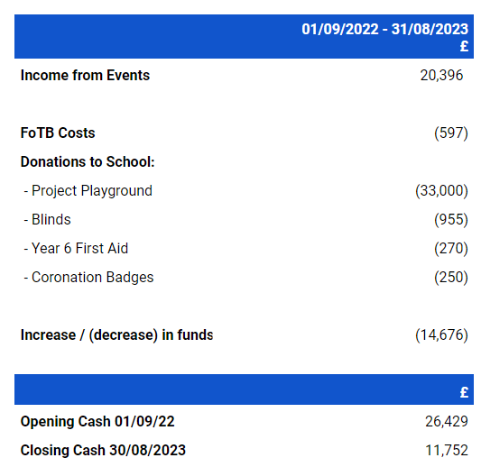
Treasurers Report - 2023

Slide 9


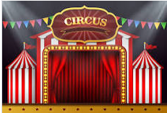



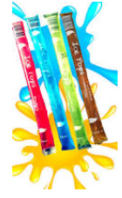

Fund Raising in Year
Lottery
£1,565
Colour Run
£1,705
Cinema Nights
£2,126
Summer Fair
£3,569
Xmas Fair & Raffle
£3,250
Charities Trust
£1,000
Fashion & Fizz
£998
Playground Sales
£1,125
Xmas Disco
£630
Pedal 4 Project Playground
£980
Pre-loved Uniform
£1,128
5p Bottles
£494
Willy Wonka Bars
£602
Payroll Giving
£60
Icepops
£346
Kafeine Coffee
£210
Year 4 Cake Sale
£138

Slide 10
Where has the £ been spent?
Blinds for the classrooms - £955
First Aid training - £270
Coronation Badges - £250
Project Playground - £33,000

Slide 11
Project Playground Update
Top Playground Tarmac
  Painted
  Basketball hoops
Bottom Playground Tarmac

Slide 12
Fundraising for this Year
Reading Shed
Books & artist for the Reading Shed
Markings on the bottom playground
Tech equipment i.e. ipads
Tuck Shop Shed
Notes:
Reading Shed – is a request from the school. The idea is create a quiet play zone for the children. Ideally a nice, wooden shed with outdoor use bean bags, so the children can sit quietly and chill if they want to. Having a proper seating area would be great, so that is a potential. We expect it would need, for example, paving underneath for the shed to sit on.
If we were able to invest in a Reading Shed then we would need books and potentially an artist to come and paint it, perhaps do a mural, so it looks attractive and appealing to the children. Later in the year, we may ask parents to ‘buy a new book’ for it, to build it up into a really useful resource for the children to enjoy.
Markings on the bottom playground – Mrs M will speak to the school counsel and ask for their ideas and consult with them about what they would like to see marked on the playgroun, for example; a map of the UK or some games drawn on.
Tech equipment – The computers and ipads are a number of years old, they need replacing, that is a significant cost, but it is something crucial to the children’s learning, so we will be looking to donate a large proportion of this year’s fundraising into tech equipment. If any parent orks for an organisation that could provide discounts on this type of equipment, that would fantastic. Please have a chat with Mrs M.
Tuck Shop Shed – The idea is a shed within the playground where we could store the ice pops, treats and FOTB equipment, the 2 x locks ups are full to brimming and we need more space.

Slide 13
Friends of Tithe Barn Fundraising
School Lottery
Clothes Recycling Bin in the car park
Payroll Giving
Charities Trust – 12 days of giving
Match Funding
Coffee Van
Notes:
Large organisations have various schemes for charity nominations and grants for example, Tesco, Morrisons etc and some parents may work for large organisations who do matched funding for an event. If this is something anyone feels they could help with ie: writing bids, applying for grants or asking their employer for matched funding, that would be much appreciated.

Slide 14
Events For Academic Year 2023/2024
06/10/23 Cinema Night
01/12/23 Santa Dash & Christmas Event
07/12/23 Christmas Disco
02/02/24 Cinema Night
18/05/24 Circus
05/07/24 Colour Run
06/07/24 Summer Fair
Notes:
We welcome feedback regarding the fundraising events and are always looking to implement suggestions from members and our children. If anyone wants to suggest another event or fancies organising something, then great! Fashion & Fizz was a great success last year, if anyone wants to run it again or any other night, go for it. Please chat to us or Mrs Muncaster.
It is also crucial that we highlight we are struggling for volunteers at events, we are roping in our friends to help out as we have so few people putting their hands up. The events won’t be able to go ahead unless we get decent numbers to help out., We appreciate everyone has young families, jobs, homes to keep but even just a couple of hours for i.e. cinema night would be great. Thank you!

Slide 15
Any Other Business?

Slide 16
Thank you
Notes:
Thank you for your time today and to everyone who works so hard baking cakes, collecting prizes, trawling the internet to find cheap props or gifts, attending meetings, volunteering at events – it is all so hugely appreciated!
Minutes will be distributed by school via email
Or you can ask any Trustee for a copy and we can email across

